Slide 1

Project Title -Seasonal Agricultural Analysis
Student Name : RAJA THRILOKESH GANDHAM
College Name- Pragati Engineering College
AICTE STU ID : STU6a0c7ba72c2c01779202983

Slide 2

PROBLEM STATEMENT
Agricultural activities are influenced by seasonal variations in environmental conditions, farming practices, resource availability and market conditions. As a result, agricultural performance may differ from one season to another. However, raw agricultural data does not clearly explain how agricultural performance changes across seasons or what patterns can be observed in different seasonal conditions. The problem is to analyze the given agricultural dataset and investigate seasonal differences in agricultural performance by identifying meaningful patterns, trends, relationships and variations within the available data.

Slide 3
Project Description
Seasonal Agriculture Performance Analysis is a data analysis project that examines agricultural activities across different seasons, geographical regions, and farming conditions.
The project analyzes factors such as rainfall, temperature, humidity, soil conditions, crop yield, resource usage, water efficiency, production costs, revenue, and profit to understand how agricultural performance varies across Kharif, Rabi, and Zaid seasons.
The analysis uses data cleaning, statistical analysis, comparisons, correlations, and visualizations to identify seasonal patterns, relationships, variations, and unusual observations.
The final outcome is to generate evidence-based insights and recommendations that can support better seasonal agricultural planning and resource management.

Slide 4

WHO ARE THE END USERS?
END USERS
Farmers – Understand seasonal crop performance, resource usage, and profitability.
Agricultural Planners – Use seasonal trends and regional comparisons for better planning.
Agricultural Departments – Analyze seasonal agricultural performance across regions.
Agricultural Researchers – Study relationships between environmental conditions and crop outcomes.
Agribusiness & Market Analysts – Understand seasonal changes in production, costs, revenue, and profit.
Agricultural Consultants – Provide data-driven recommendations for improving farm management.

Slide 5

Technology Used
Python – Main programming language for data analysis
Pandas – Data loading, cleaning, manipulation, and analysis
NumPy – Numerical operations and data processing
Matplotlib – Creating charts and visualizations
Seaborn – Statistical and comparative visualizations
SciPy – Statistical analysis and ANOVA testing
Google Colab – Development and execution environment
Jupyter Notebook – Documentation and presentation of the analysis

Slide 6
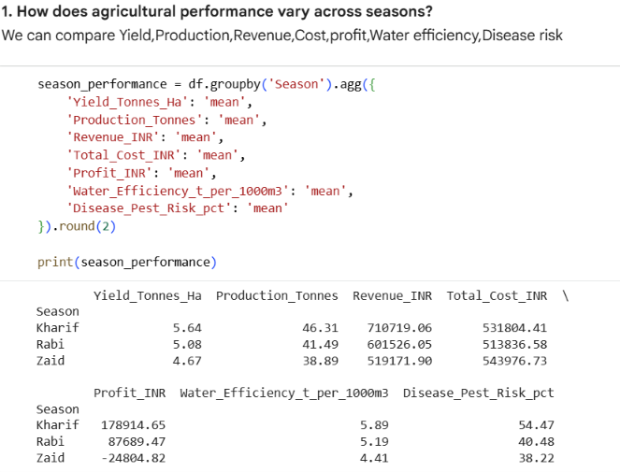
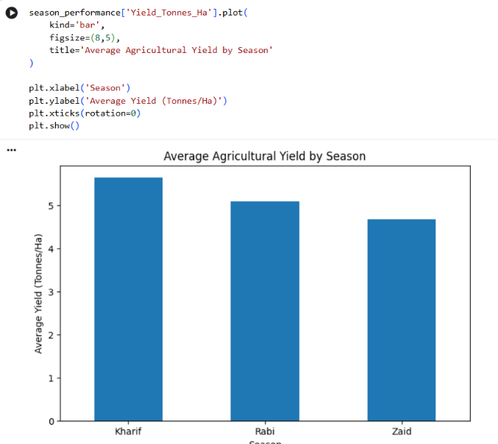
RESULTS
Kharif showed the highest average agricultural performance, followed by Rabi and Zaid. Kharif recorded higher average yield, revenue, profit and water efficiency compared with the other seasons.
[Add screen shots of your code ]
Bar chart comparing Yield / Revenue / Profit across Kharif, Rabi and Zaid.

Slide 7
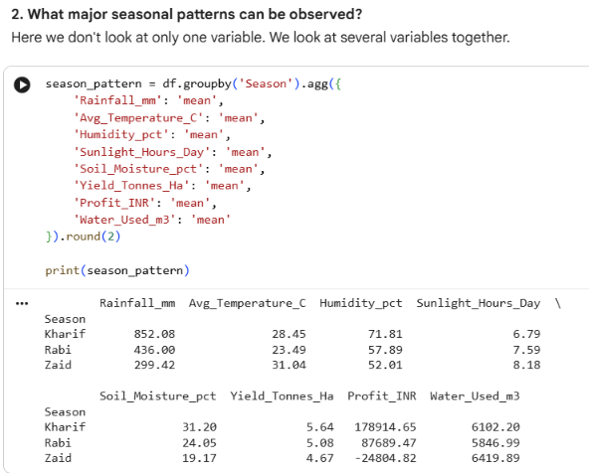
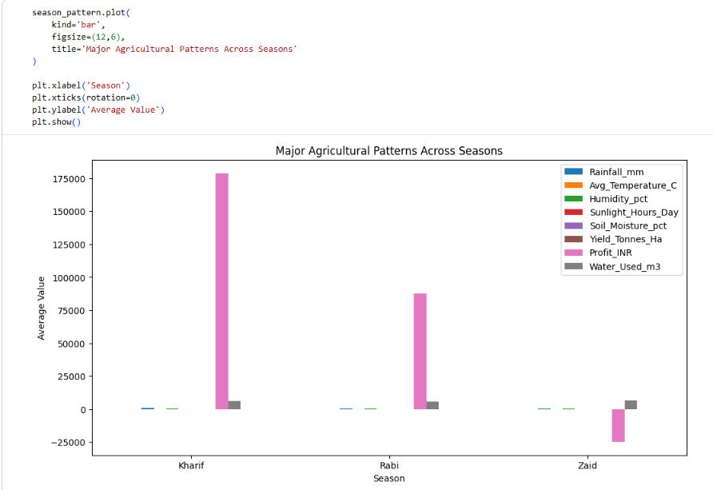
RESULTS
Major patterns can be identified by comparing agricultural performance, environmental conditions, resource usage, and economic outcomes across different seasons.
The visualization highlights clear seasonal differences in rainfall, temperature, soil moisture, sunlight, and crop yield, showing that agricultural conditions change considerably between seasons.

Slide 8
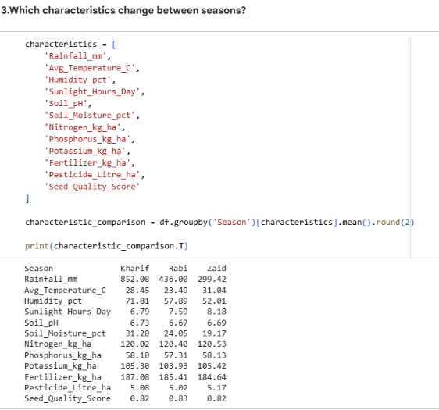
RESULTS
Several environmental characteristics change significantly. Average temperature increases from 23.49°C in Rabi to 31.04°C in Zaid, while soil moisture decreases from 31.20% in Kharif to 19.17% in Zaid.

Slide 9
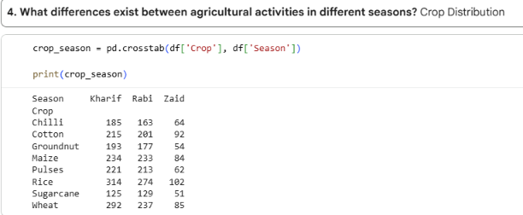
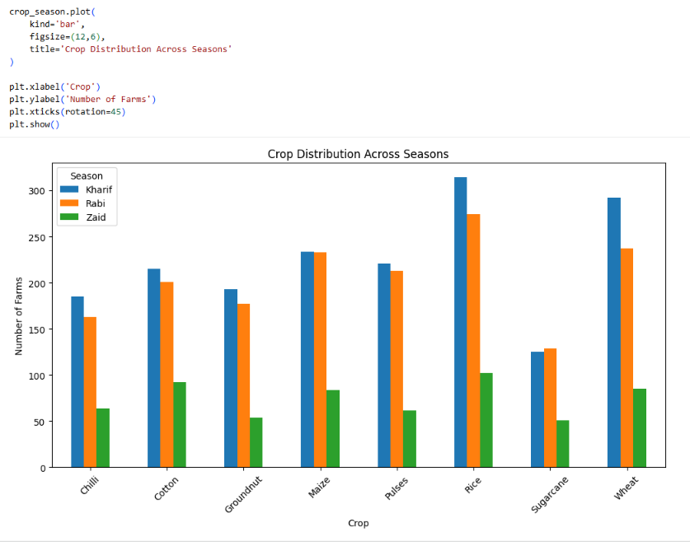
RESULTS
Crop distribution and irrigation methods are present in all three seasons. For example, Rice and Wheat are common crops, while Flood irrigation is the most frequently used irrigation method across seasons.
Visualization: The visualization shows that agricultural activities are distributed across all seasons, with some differences in crop composition and irrigation practices.

Slide 10
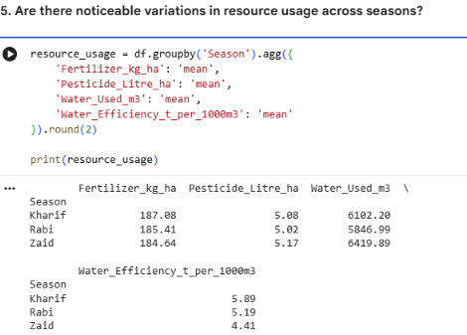
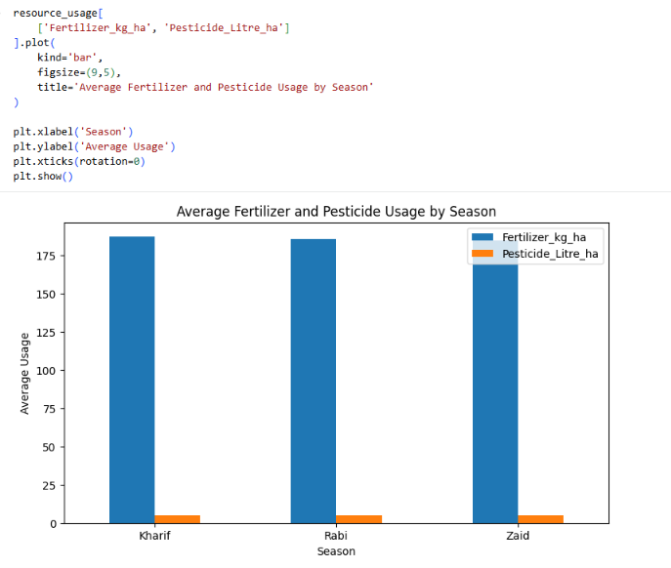
RESULTS
Average water usage is highest in Zaid (6,419.89 m³), followed by Kharif (6,102.20 m³) and Rabi (5,846.99 m³). Fertilizer usage remains relatively similar across seasons.
[Add screen shots of your code ]
Visualization: The graph shows that Zaid requires more water despite receiving less rainfall, while fertilizer and pesticide usage remain relatively stable across seasons.

Slide 11
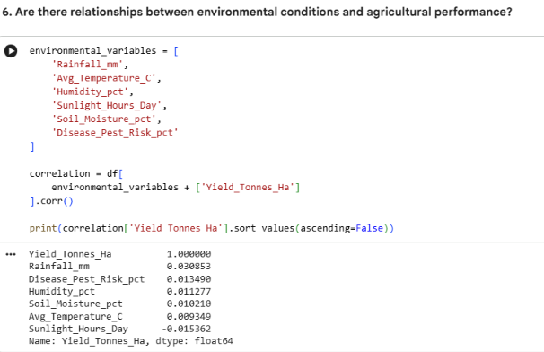
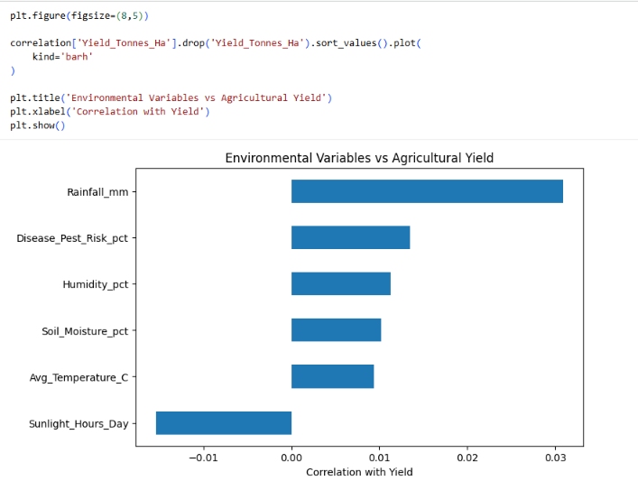
RESULTS
The seasonal averages show that Kharif has higher rainfall and soil moisture along with the highest yield. However, the correlation analysis between individual environmental variables and yield is very weak, indicating that no strong linear relationship is evident from these variables alone.
[Add screen shots of your code ]
Visualization: The visualization shows that seasons with more favorable overall environmental conditions tend to have higher average yields, although the relationship between individual environmental factors and yield is not strong.

Slide 12
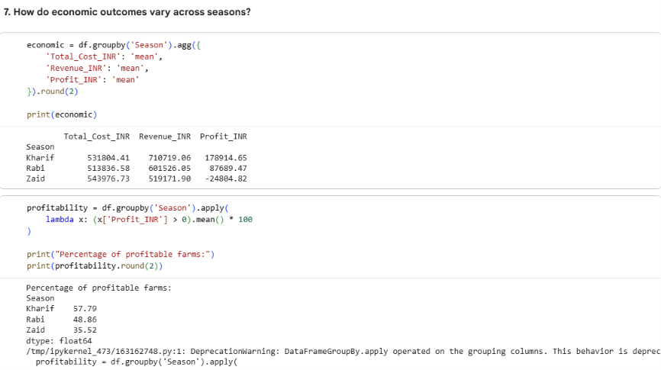
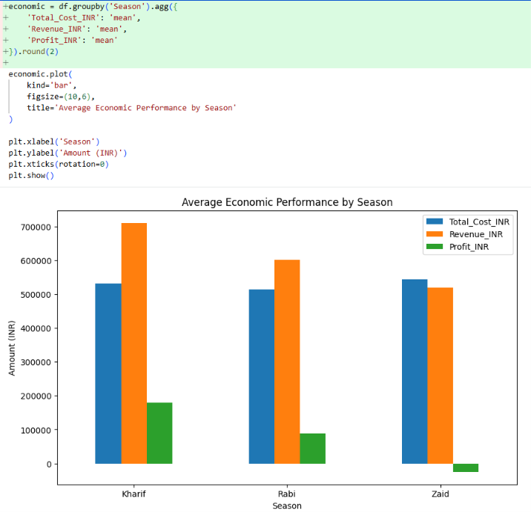
RESULTS
Kharif has the highest average revenue (₹710,719) and profit (₹178,915). Rabi has an average profit of approximately ₹87,689, while Zaid has an average loss of ₹24,805.
[Add screen shots of your code ]
Visualization: The graph clearly shows Kharif as the most economically successful season, while Zaid has the weakest economic performance and an average negative profit.

Slide 13
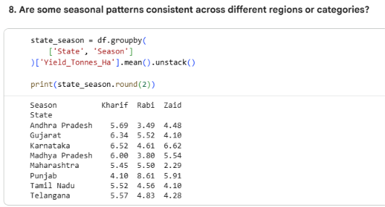
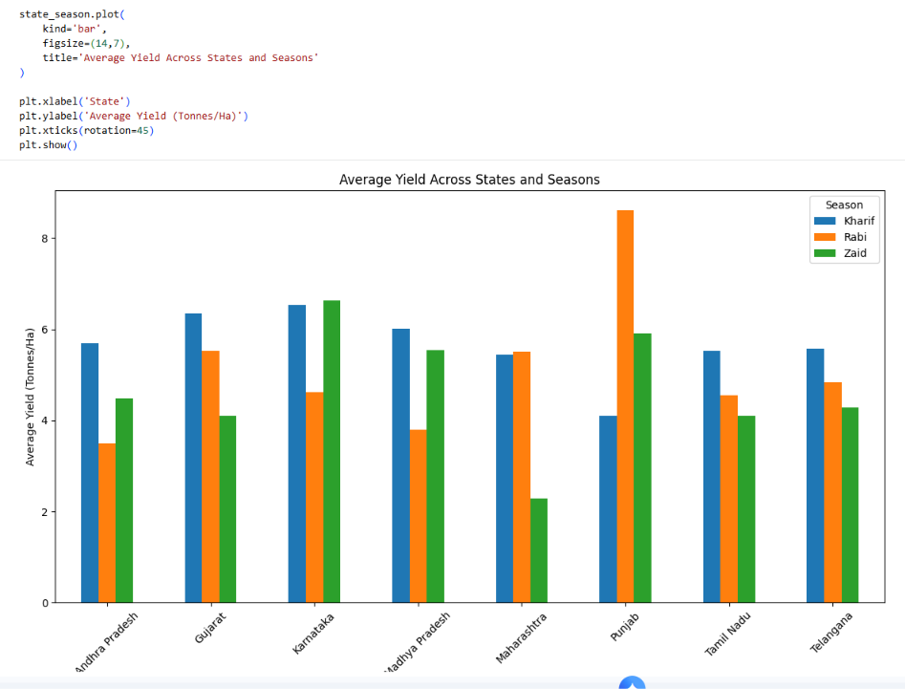
RESULTS
The seasonal performance is not completely consistent across states. For example, Punjab has its highest average yield in Rabi (8.61 tonnes/ha), whereas Gujarat performs best in Kharif (6.34 tonnes/ha), and Karnataka performs slightly better in Zaid (6.62 tonnes/ha)
[Add screen shots of your code ]
The seasonal performance is not completely consistent across states. For example, Punjab has its highest average yield in Rabi (8.61 tonnes/ha), whereas Gujarat performs best in Kharif (6.34 tonnes/ha), and Karnataka performs slightly better in Zaid (6.62 tonnes/ha)

Slide 14
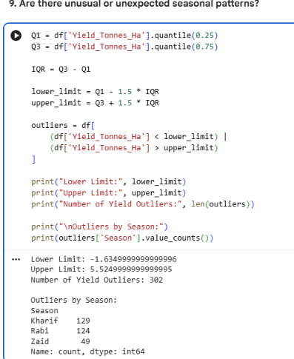
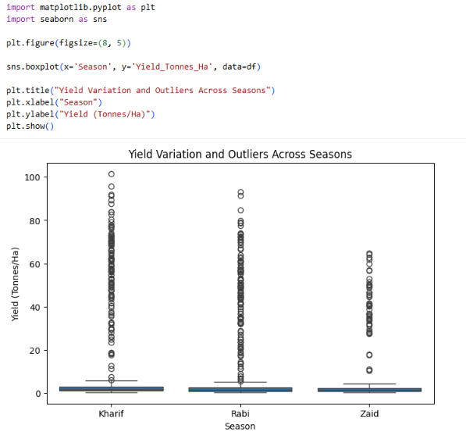
RESULTS
Some unusual regional patterns are visible. For example, Punjab's Rabi yield (8.61 tonnes/ha) is much higher than its Kharif yield (4.10 tonnes/ha), while Karnataka's Zaid yield (6.62 tonnes/ha) slightly exceeds its Kharif yield (6.52 tonnes/ha).
[Add screen shots of your code ]
The chart highlights these deviations from the overall seasonal trend and shows that certain regions behave differently from the general pattern.

Slide 15
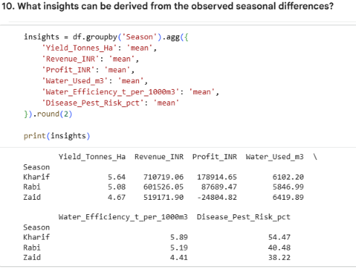
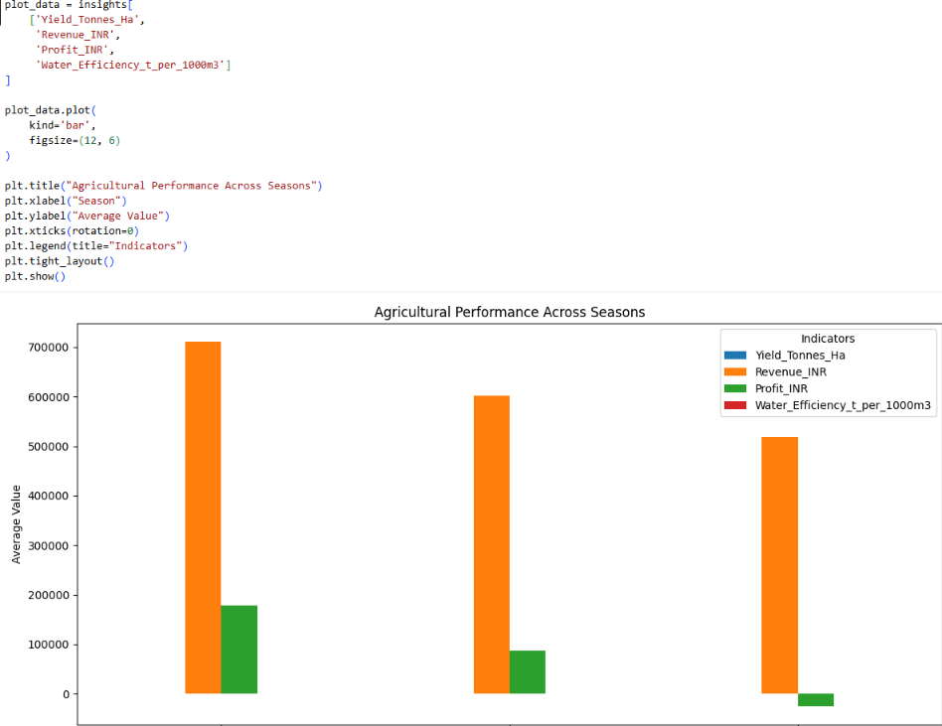
RESULTS
The analysis indicates that Kharif generally provides the highest yield, revenue, profit, and water efficiency, while Zaid has the lowest yield and water efficiency and records negative average profit.
[Add screen shots of your code ]
Visualization: The visualizations make it easy to identify Kharif as the strongest overall season and Zaid as the weakest, while also revealing regional and environmental differences.

Slide 16
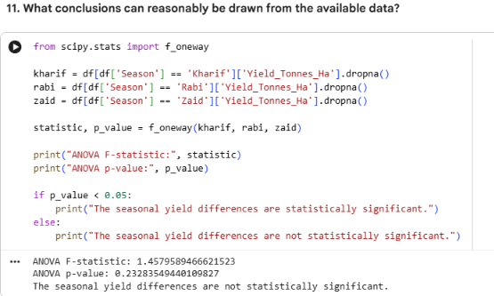
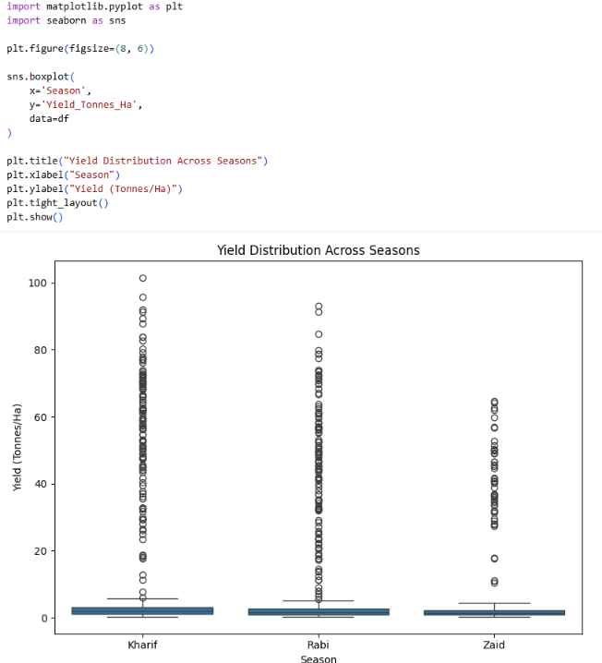
RESULTS
The analysis suggests that agricultural performance varies substantially by season. Kharif has the strongest overall performance, while Zaid faces lower yield, higher water usage, lower water efficiency, and negative average profit.
[Add screen shots of your code ]
Visualization: The charts provide a clear overall picture of seasonal differences in agricultural, environmental, resource, and economic performance, supporting the numerical findings.

Slide 17
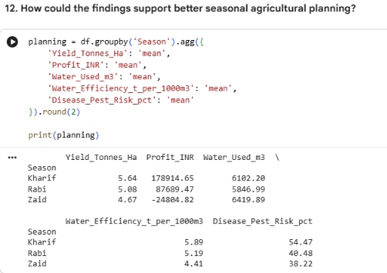
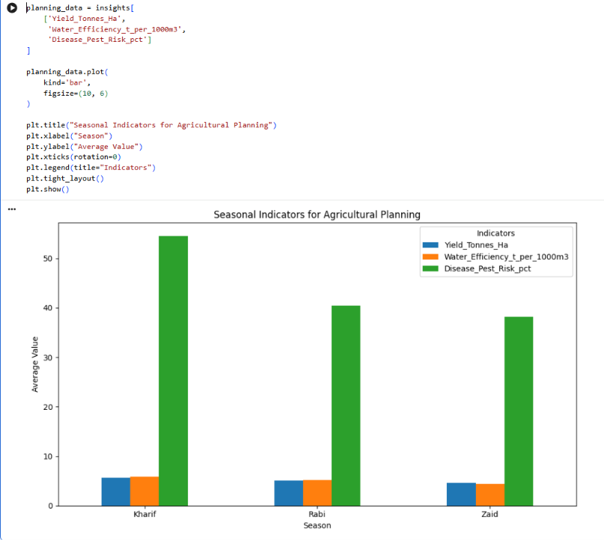
RESULTS
Code / Output: The results can help farmers and planners identify seasons with better productivity and profitability, while paying particular attention to water management and economic risks during Zaid.
[Add screen shots of your code ]
The visualization compares the key indicators across Kharif, Rabi, and Zaid seasons. It makes seasonal differences easier to understand and shows how the findings can be used for more effective agricultural planning.

Slide 18
Future scope
1.Predictive Analysis – Future work can use machine learning to predict crop yield, profit, and agricultural performance for different seasons.
2.Real-Time Data Integration – Weather forecasts, rainfall, soil moisture, and other real-time environmental data can be incorporated to improve seasonal decisions.
3.Crop Recommendation – The analysis can be extended to recommend suitable crops for each season based on yield, water requirements, soil conditions, and expected profit.
4.Regional-Level Planning – Future analysis can study seasonal patterns across different geographical regions and provide region-specific agricultural recommendations.
5.Resource Optimization – Water, fertilizer, pesticide, and other resource usage can be optimized to improve productivity while reducing unnecessary consumption.
6.Early Risk Detection – Disease and pest risk data can be used to develop early-warning systems for farmers.
7.Interactive Dashboard – The project can be developed into an interactive dashboard where users can select a season or region and view agricultural performance and recommendations

Slide 19
GitHub Link
GitHub link
https://github.com/25A31A42H5/Seasonal-Agriculture-Performance-Analysis.

Slide 20
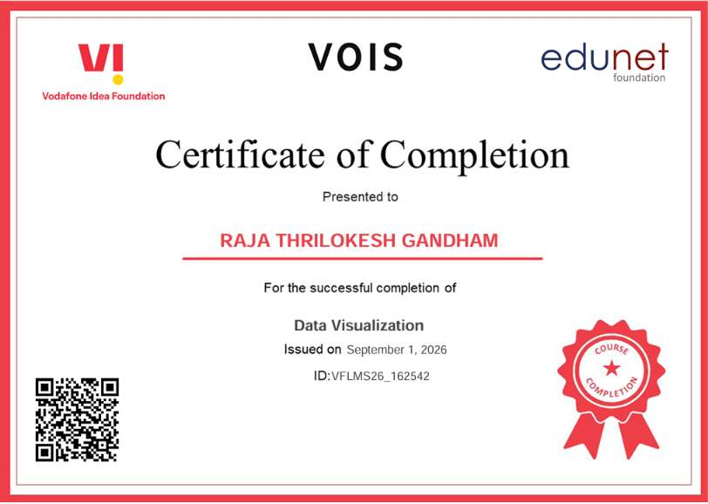
VOIS Course completion certificate - Course name- Data Visualization

Slide 21
Thank you
I sincerely thank you for taking the time to review my project. I am grateful for your valuable feedback, guidance, and suggestions, which will help me improve my work and learning.
Thank you for your time and support.
.
.

